Slide 1
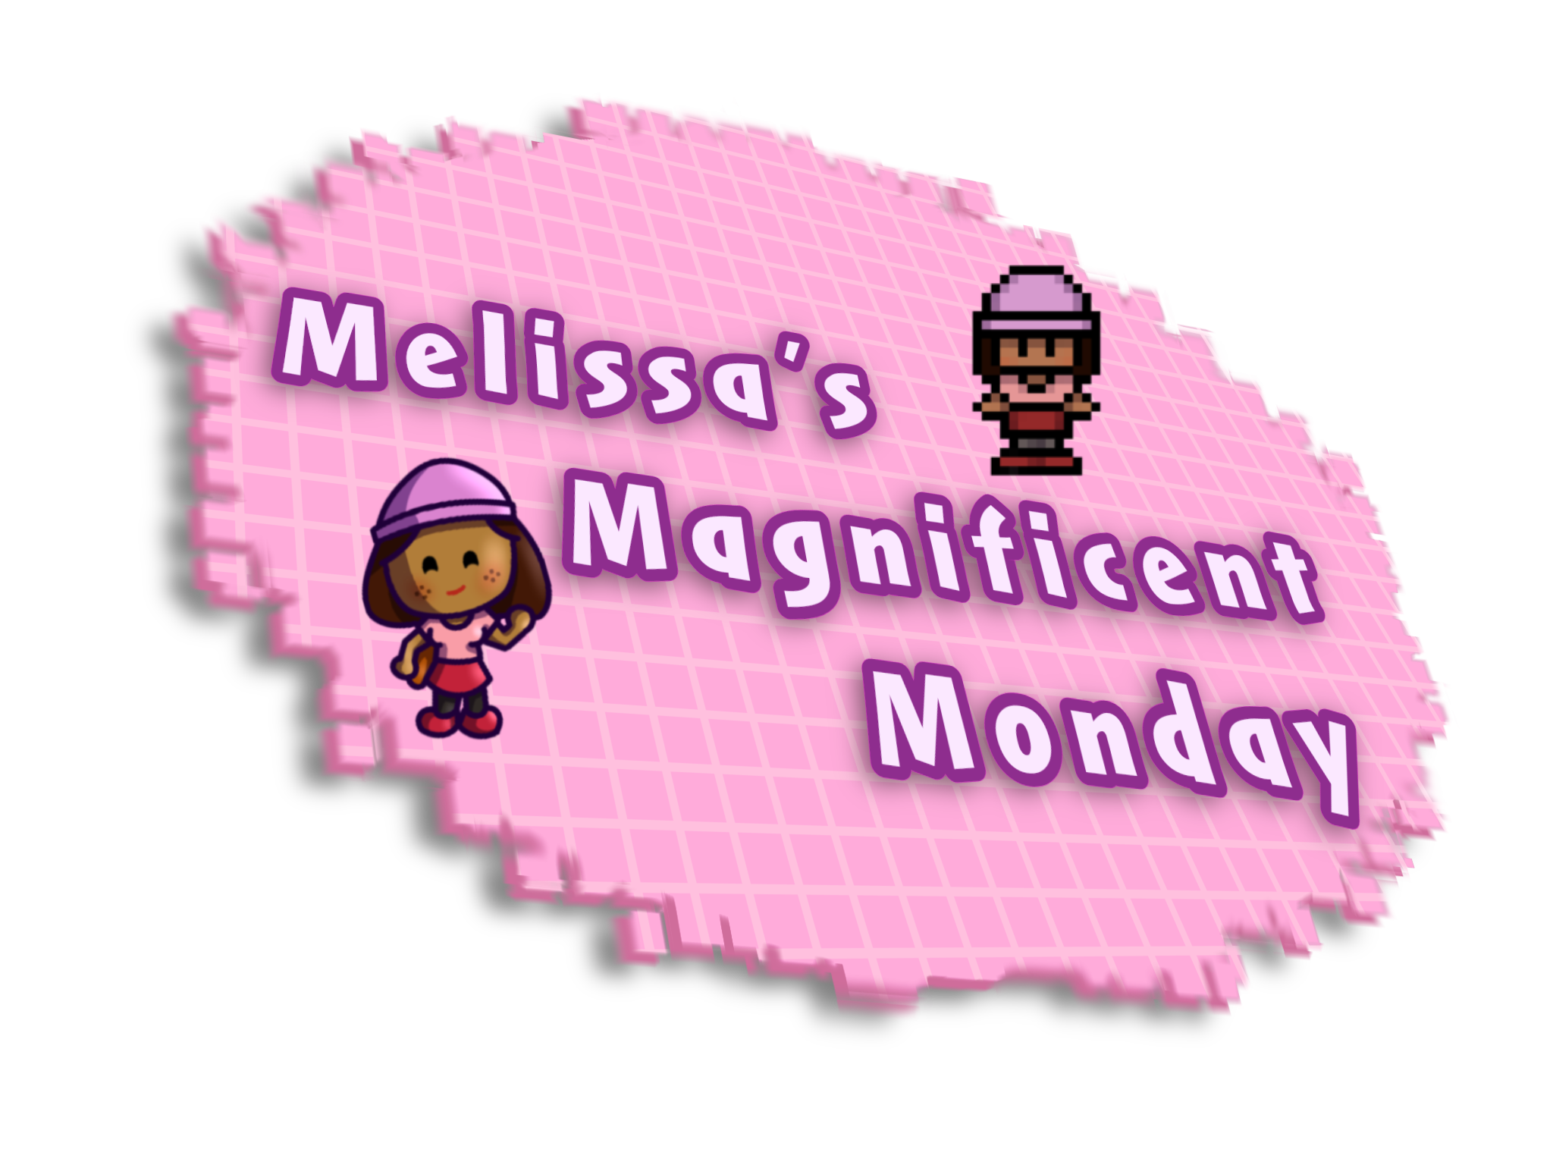
Team 6 Game
How did it go ?
What’s our games about ?
Every member's work
By Oba, Hamza, Ronnie, Oneish, Khayne, Lenny, Daniel and Chibu

Slide 2

It went alright
Game about Melissa’s first day in university.
She’s trying to make new friends.
She’s to shy to speak but the Narrator give her confidence.
Exploring the game lab and playing mini-game to help to unlock new dialogue option
Making new friends by the end of the day.

Slide 3
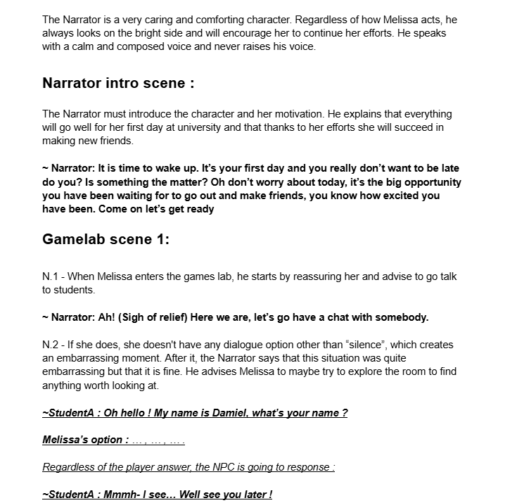
Daniel – Game Design
Made the design document
Wrote the script with Hamza

Slide 4
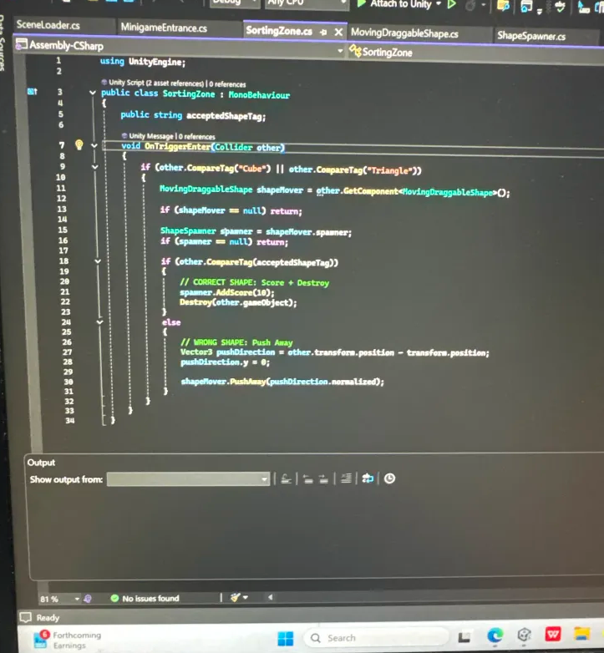
Oba - Programming
Code and scene for the prototype.
All mini-games code.
All the debugging.
Present every day, very good team member.

Slide 5

Chibu – Music and sound effect
Game Over sound
Did all the music and the sound for the game.
Provided al the music and sound very quickly.
Winning sound
Title screen
Game Lab
Silhouette mini game
Shape mini game

Slide 6
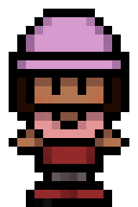



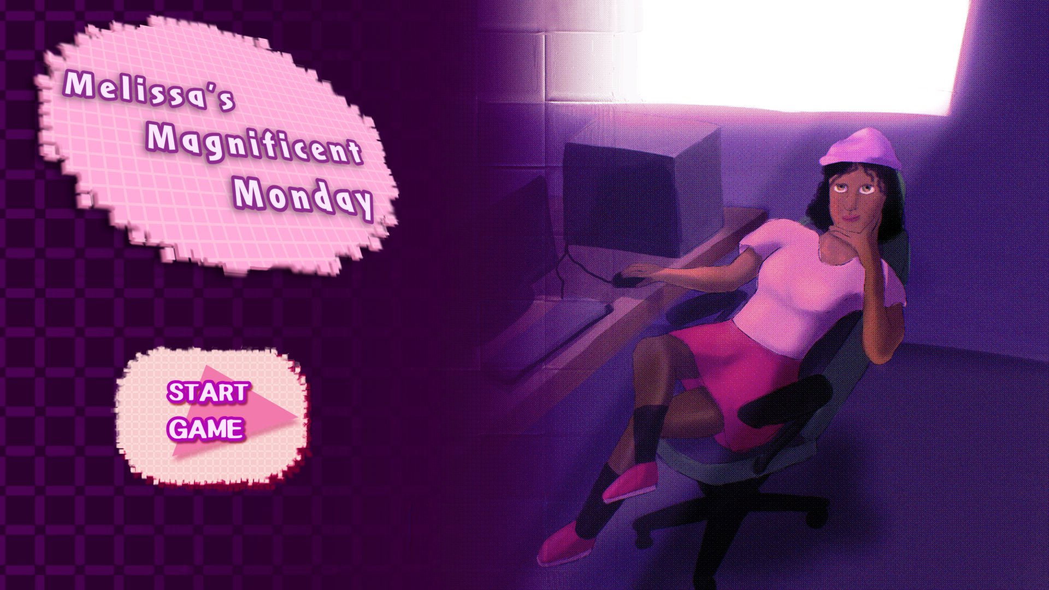
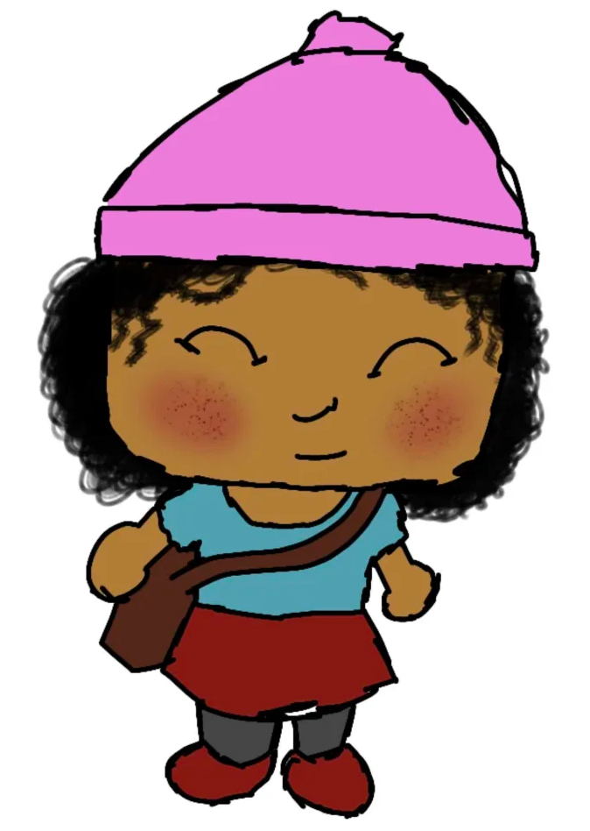

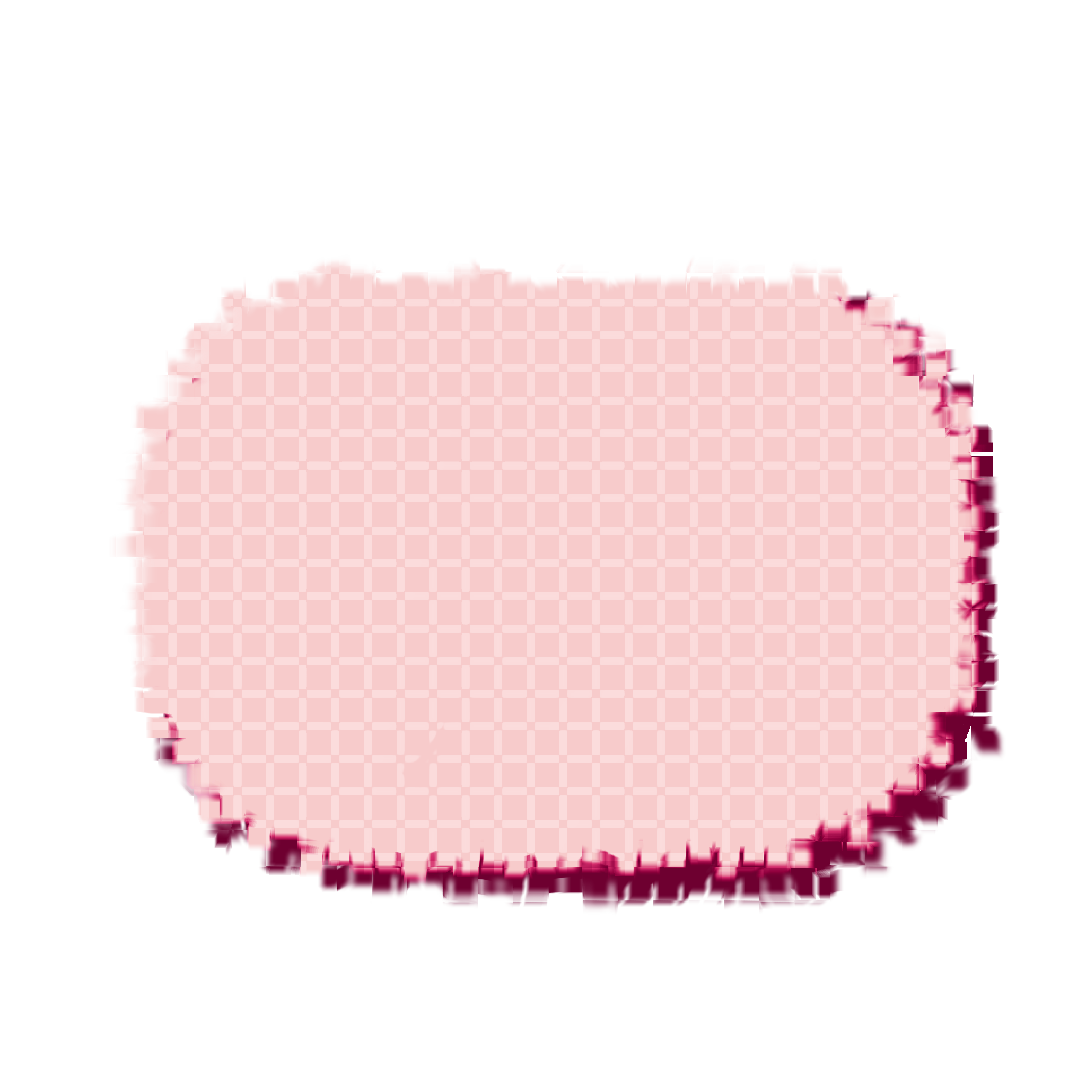
Lenny – 2D Artist
Done every 2D visuals that are not mini-games related.
Constantly working and upgrading materials.
Made the UI.
Designed the main character.

Slide 7
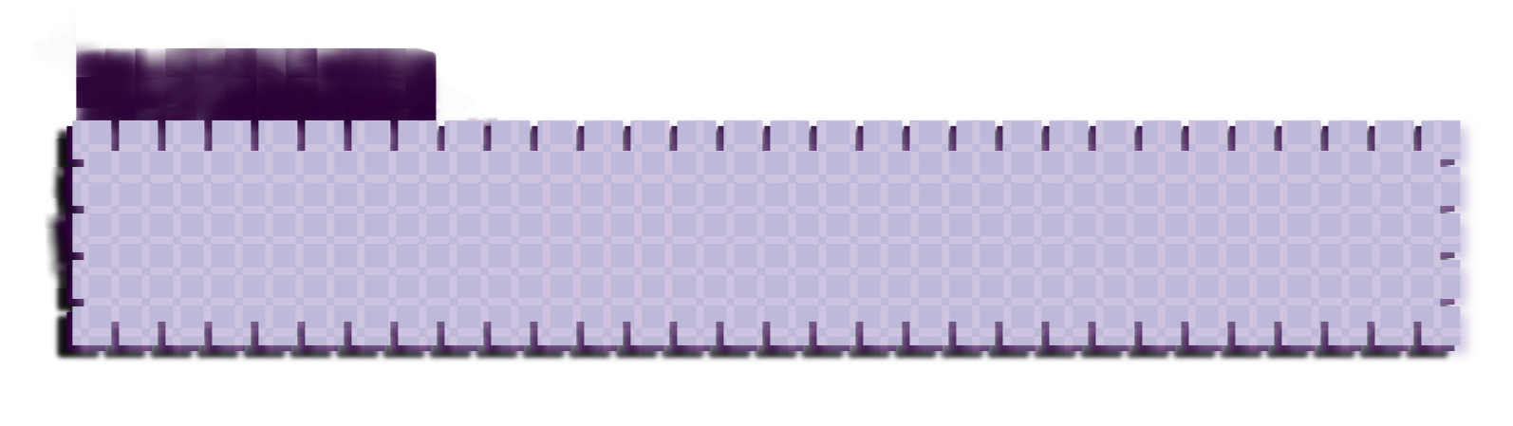
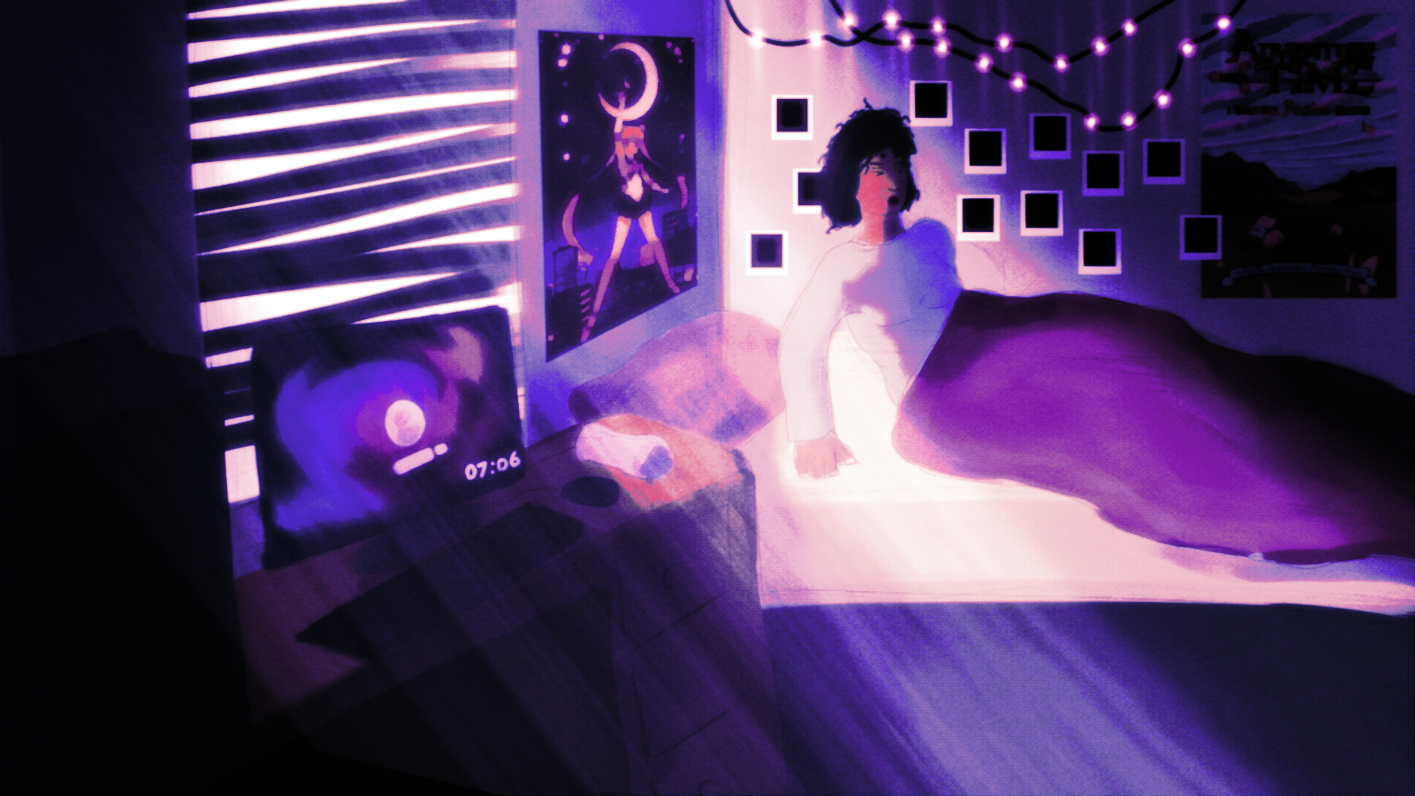
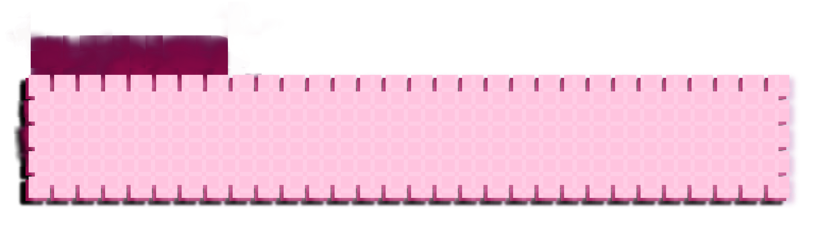

Slide 8
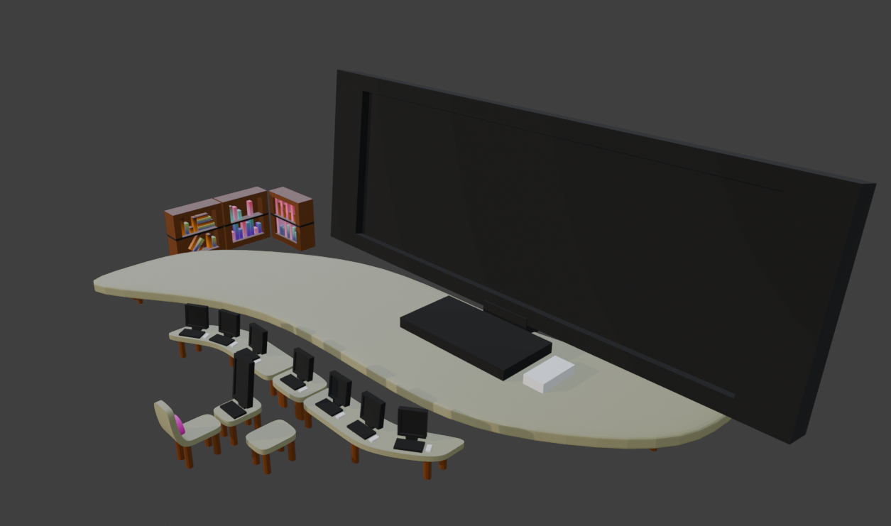
Oneish – 3D Art
Made all 3D Models for the game.
Object & characters.
Have made the pixel art character into 3D Models.
Attended every day and provided materials quickly.

Slide 9
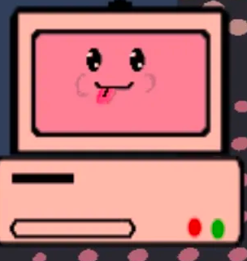
Ronnie – 2D Artist
Made all the background and materials for the mini-games.

Slide 10
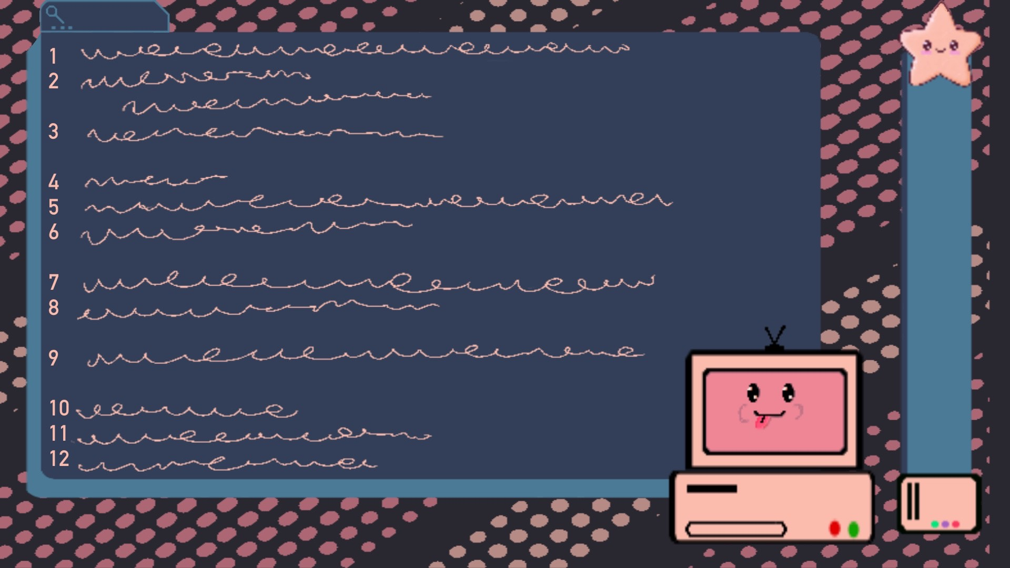

Slide 11
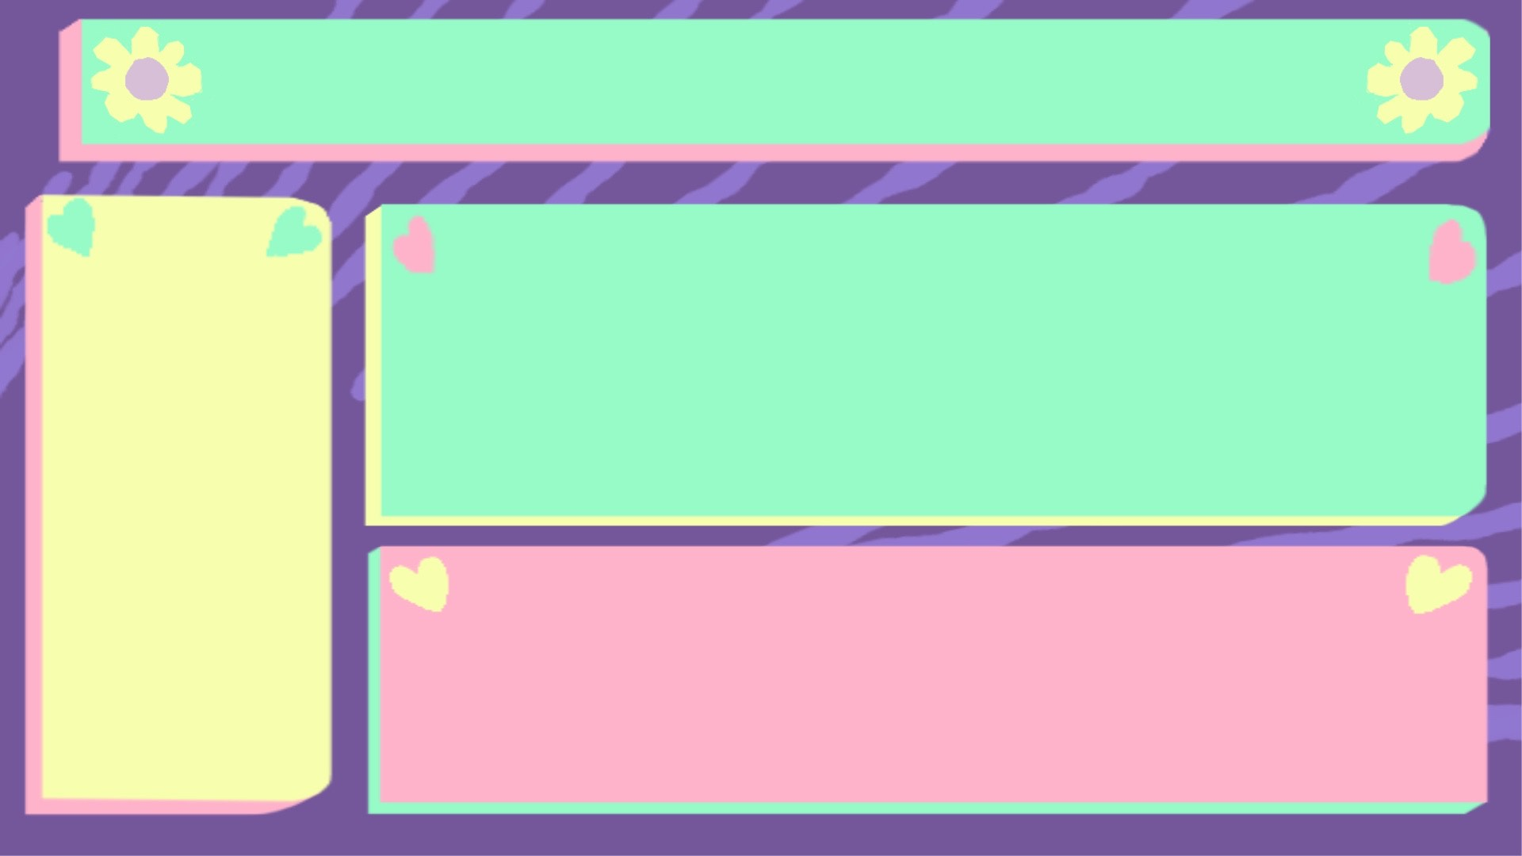

Slide 12


Slide 13
Khayne - Programming
Camera movement.
Worked with Oba on dialogue system.

Slide 14
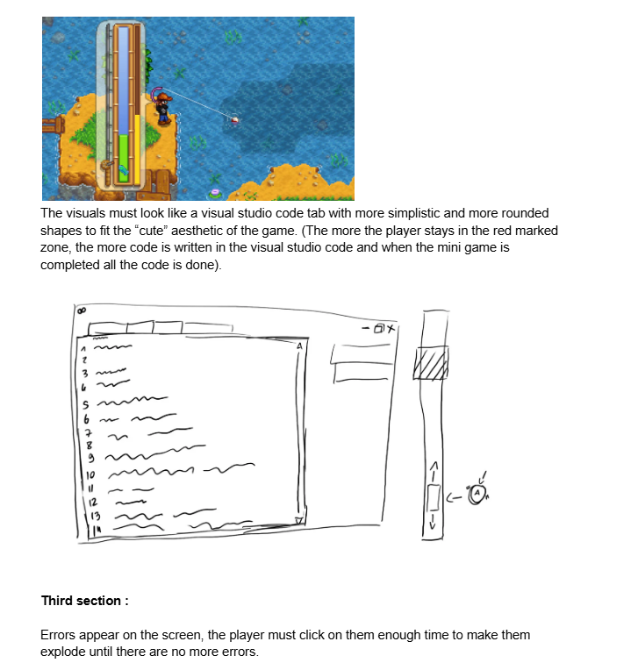
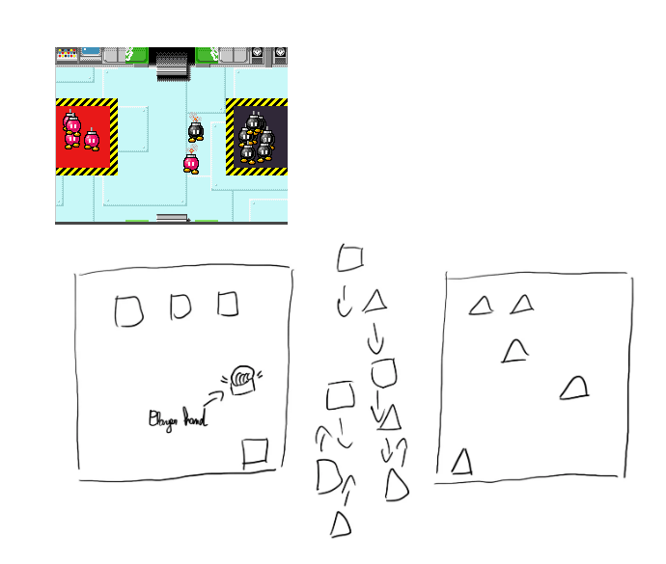
Hamza – Game Design / Producer
Designed the main level and all the mini-games.
Wrote the script with Daniel.
Created and updated the asset list.
Voice the Narrator.
Managed the team works.

Slide 15
